Slide 1
Introduction to Information Systems and Programming
Visitor Design Pattern

Slide 2
Visitor
Useful if you need to perform operations across a diverse set of objects
GoF: “Allows for one or more operation to be applied to a set of objects at runtime, decoupling the operations from the object structure”
Provide additional functionality to a class without changing it

Slide 3
Example: Postage
Postage calculation depends on the item type:
Book
CD
Clothing
Also depends on where the item is sent to
Given a list of items of variety types, determine the total postage cost

Slide 4
Non-visitor design
public static double calPostage(ArrayList<Object> items) {
double total=0;
for (Object o: items) {
if (o instanceof Book) {
...
}
else if (o instanceof CD) {
...
}
else if (o instanceof Clothing) {
...
}
else
throw new AssertionError("not supported");
}
return total;
}
-Another procedure for another region

Slide 5
Visitor Design Pattern is a more OO way to perform operation on a list of items
Non-Visitor Design:
…
Item1
Item2
Item3
processing()
Visitor Design:
Visitor
(An object of processing)
…
Item1
Item2
Item3

Slide 6
Visitor Design Pattern
Visitor
Visitable
+visit(Item1)
+visit(Item2)
+accept(Visitor)
Item1
accept(Visitor v):
v.visit(this)
ConcreteVisitor
visit(Item1):
// processing for Item1
visit(Item2):
// processing for Item2
Item2
visit()
accept(Visitor v):
v.visit(this)

Slide 7
Visitor Design Pattern: Visitor Interface
// Visitor.java
public interface Visitor {
void visit(Book b);
void visit(CD c);
void visit(Clothing c);
}
-Different visit methods for different object types to be processed
-Later, use method overloading to pick the method for processing (instead of if-then-else)

Slide 8
PostageVisitor.java : concrete class implements Visitor
public class PostageVisitor implements Visitor {
private double total =0;
@Override
public void visit(Book b) {
total += b.getWeight() * 5;
}
@Override
public void visit(CD c) {
...
}
}
-Concrete implementation of Visitor provides the specifics of what to do with different object types

Slide 9
Visitable Interface
public interface Visitable {
void accept(Visitor v);
}
- Allows the Visitor to be passed in

Slide 10
Item implements Visitable
class Book implements Visitable {
private double weight;
public void accept(Visitor v) {
v.visit(this);
}
public Book (double weight) {
this.weight=weight;
}
public double getWeight() {
return weight;
}
}
Simple but important change to make a class visitable:
dispatch of visit depends on data type “this”

Slide 11
Test.java
ArrayList<Visitable> items = new ArrayList<Visitable>();
PostageVisitor postage = new PostageVisitor();
items.add(new Book(1));
items.add(new CD("psy"));
items.add(new Book(2));
items.add(new Clothing(10));
for (Visitable o: items){
o.accept(postage);
}
System.out.println(postage.getTotal());
Visitor postage visits each item one by one, processes them, information kept inside visitor

Slide 12
Advantage of Visitor
Separate out certain logic (e.g., postage calculation) from the items themselves, keeping the item classes simple
Item classes only need to implement Visitable
Add methods to classes: another concrete class implements Visitor
No need to change item classes
Enable static checking: code cannot be compiled without the visit method of the corresponding type

Slide 13
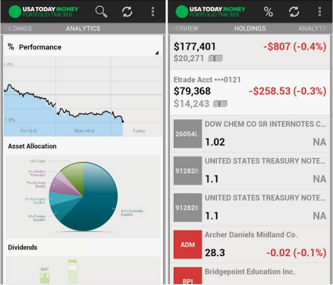
Activity
Using the Observer design pattern, develop a stock alert system that sends alerts to subscribers for any update of the stock prices
Develop StockGrabber class that keeps the list of subscribers for several stock prices, and notifies them for update
Develop StockObserver class that monitors changes in the stock prices
Develop a Test class to simulate the system

Slide 14
Activity
Use the Visitor design pattern, compute the total tax income of a list of items of the following types: Car, Alcohol, Chocolate. Two taxing systems are in place:
TaxNormal:
Car: 30%, Alcohol: 50%, Chocolate: 10%
TaxHoliday:
Car: 40%, Alcohol: 80%, Chocolate: 20%
Starting code in the course directory.

